Slide 1
Introduction to 3D Geometry
Shreyas M
B.Tech in ECE PES University Bangalore

Slide 2
Chapter Map
Section | Topics
1 | Introduction
2 | Cartesian Coordinate system
3 | Distance formula
4 | Internal Section formula
5 | External section formula
6 | Centroid of a triangle

Slide 3
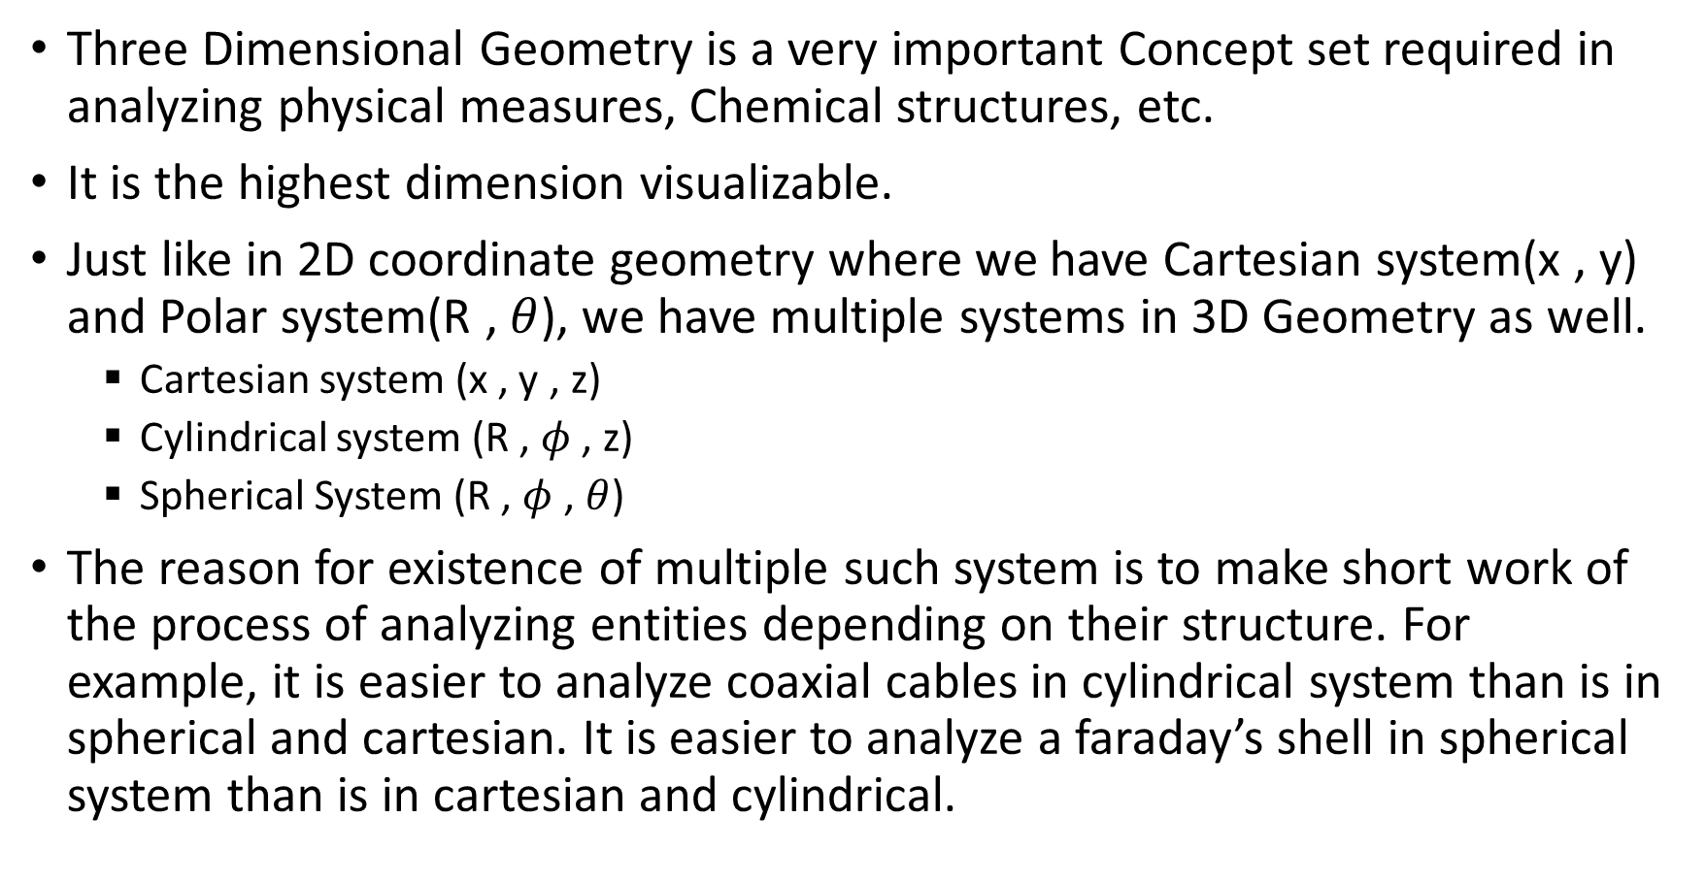
1 Introduction
Three Dimensional Geometry is a very important Concept set required in analyzing physical measures, Chemical structures, etc.
It is the highest dimension visualizable.
Just like in 2D coordinate geometry where we have Cartesian system(x , y) and Polar system(R ,$θ$), we have multiple systems in 3D Geometry as well.
Cartesian system (x , y , z)
Cylindrical system (R , $φ$ , z)
Spherical System (R , $φ$ , $θ$)
The reason for existence of multiple such system is to make short work of the process of analyzing entities depending on their structure. For example, it is easier to analyze coaxial cables in cylindrical system than is in spherical and cartesian. It is easier to analyze a faraday’s shell in spherical system than is in cartesian and cylindrical.

Slide 4
2 Cartesian coordinate system
Assume that your screen represents the 2D plane coordinate system with X and Y axis taken according to convention of 2D cartesian system.
Now visualize that there is a third axis coming out of your system towards you. That will be in 3rd dimension and will be the positive Z axis of the 3D Coordinate system. The axis going into the screen will be the negative Z axis. This can be visualized by the use of any 3D visualizing tools such as GeoGebra calculator suite.

Slide 5
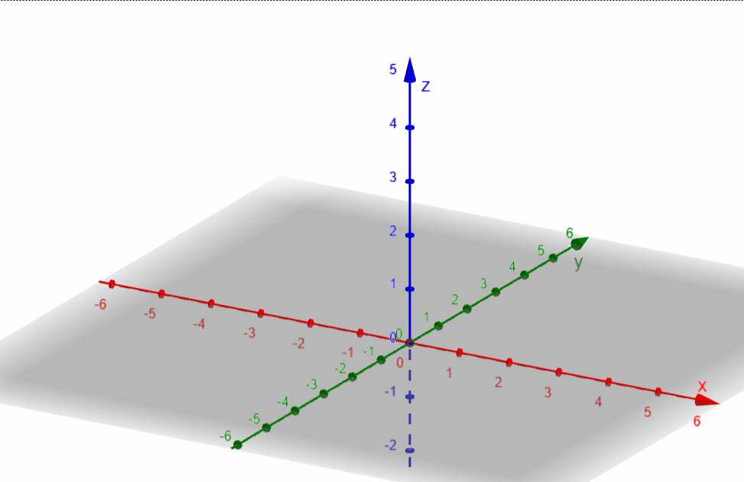
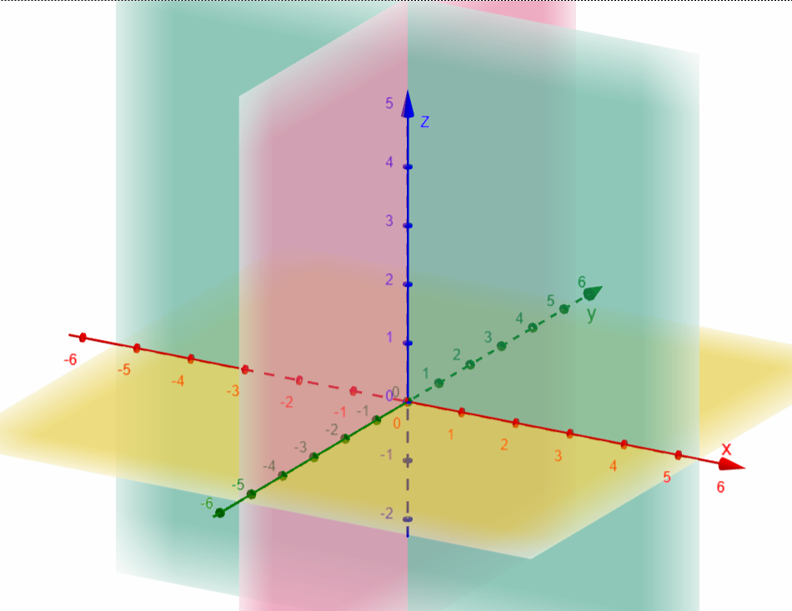
Conventionally, we represent a point in three dimension coordinate system as (X,Y,Z)
Lets say the gray plane is the plane of your screen. The Z axis is perpendicular to any line chosen n the XY plane.
Just like, in 2D the X and Y axis divides the plane to Four Quadrants, the XY, YZ and XZ planes divide space into 8 octants. Their sign convention has been discussed in the next slide.
A 3D space has 6 reference components.
X axis
Y axis
Z axis
YZ plane (if X=0) 🔴
XZ plane (if Y=0) 🟢
XY plane (if Z=0) 🟡

Slide 6
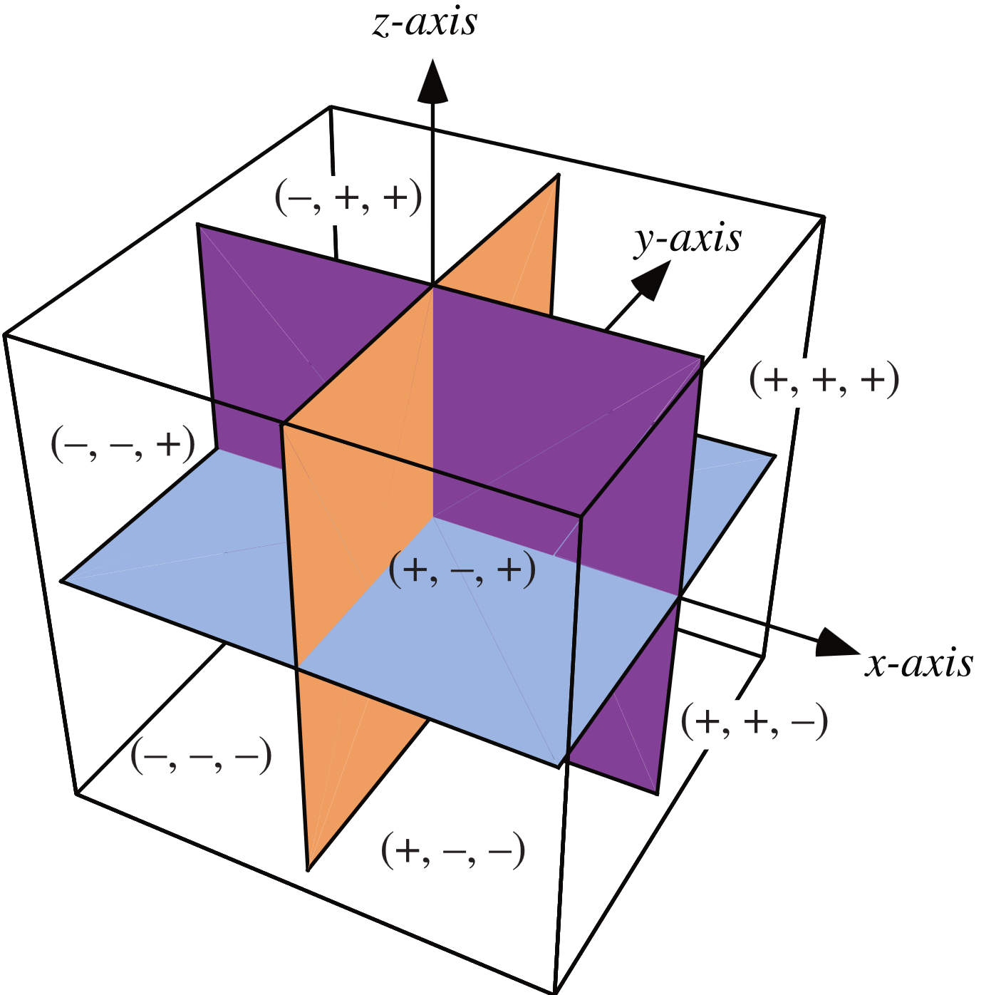
As a thumb rule, we start the Octant Labelling where we have all positive coordinates. This is to make analysis of structures easier.
Octant | X coordinate Sign | Y Coordinate sign | Z coordinate sign
I | + | + | +
II | + | + | -
III | - | + | -
IV | - | + | +
V | + | - | +
VI | + | - | -
VII | - | - | -
VIII | - | - | +

Slide 7
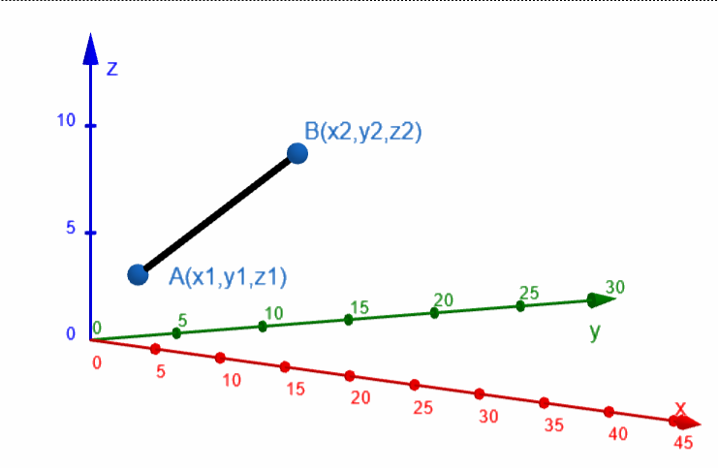
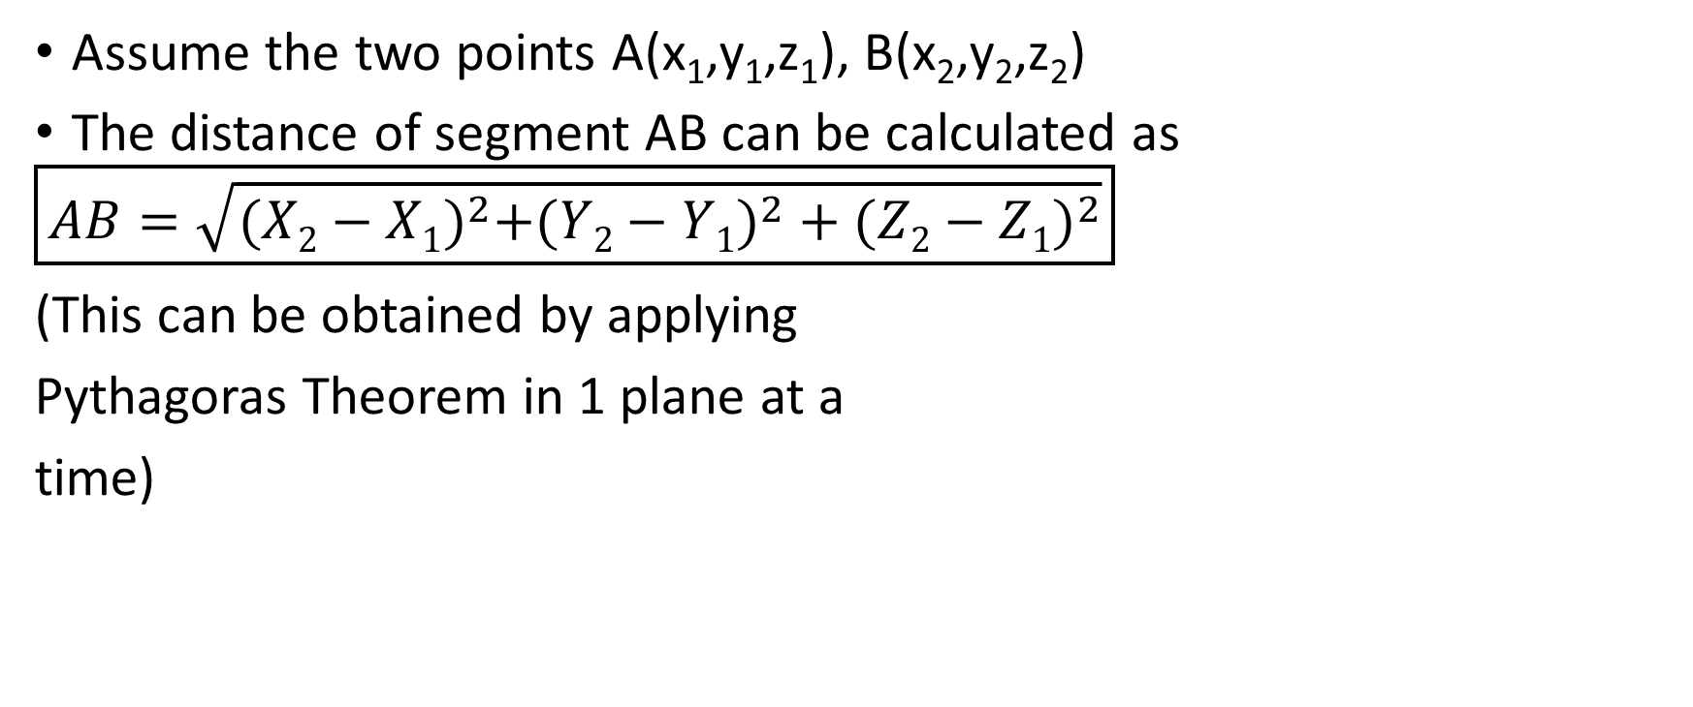
3 Distance formula
Assume the two points A(x₁,y₁,z₁), B(x₂,y₂,z₂)
The distance of segment AB can be calculated as
$$\boxed{AB=\sqrt{{(X2−X1)}^{2}+({Y2−Y1)}^{2}+{(Z2−Z1)}^{2}}}$$
(This can be obtained by applying
Pythagoras Theorem in 1 plane at a
time)

Slide 8
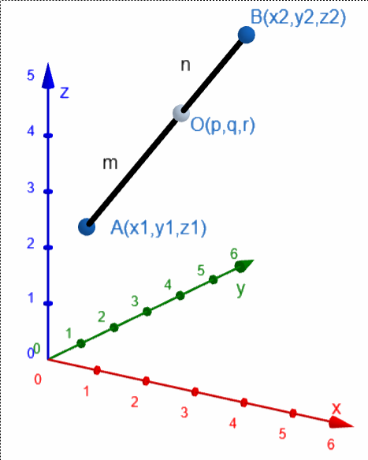
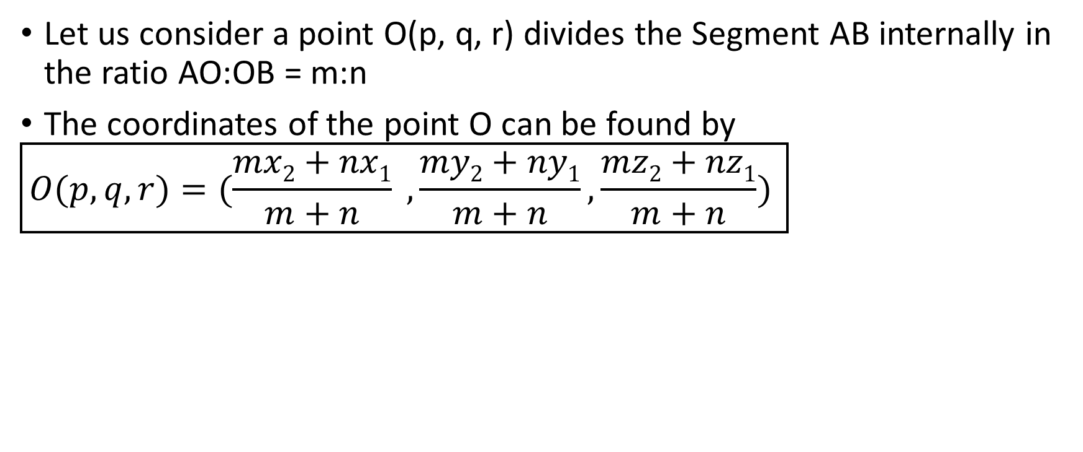
4 Internal section formula
Let us consider a point O(p, q, r) divides the Segment AB internally in the ratio AO:OB = m:n
The coordinates of the point O can be found by
$$\boxed{O(p,q,r)=(\frac{mx2+nx1}{m+n} , \frac{my2+ny1}{m+n},\frac{mz2+nz1}{m+n}) }$$

Slide 9
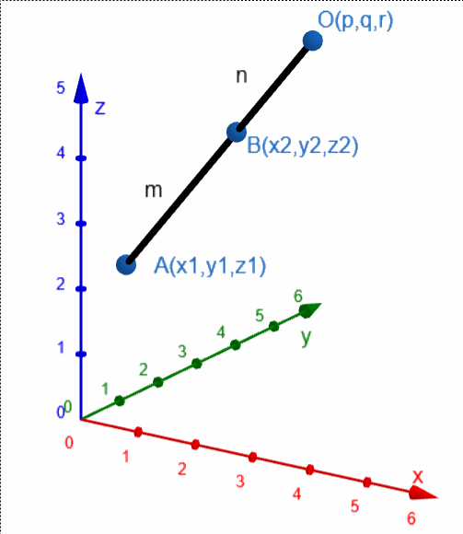
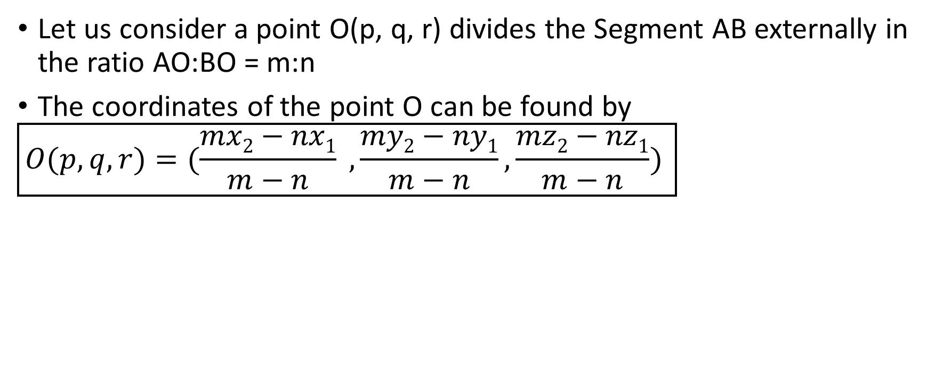
5 External section formula
Let us consider a point O(p, q, r) divides the Segment AB externally in the ratio AO:BO = m:n
The coordinates of the point O can be found by
$$\boxed{O(p,q,r)=(\frac{mx2−nx1}{m−n} , \frac{my2−ny1}{m−n},\frac{mz2−nz1}{m−n}) }$$

Slide 10
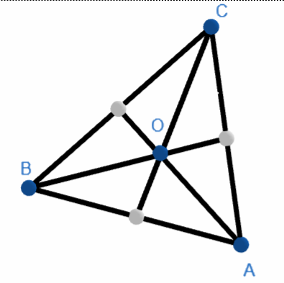
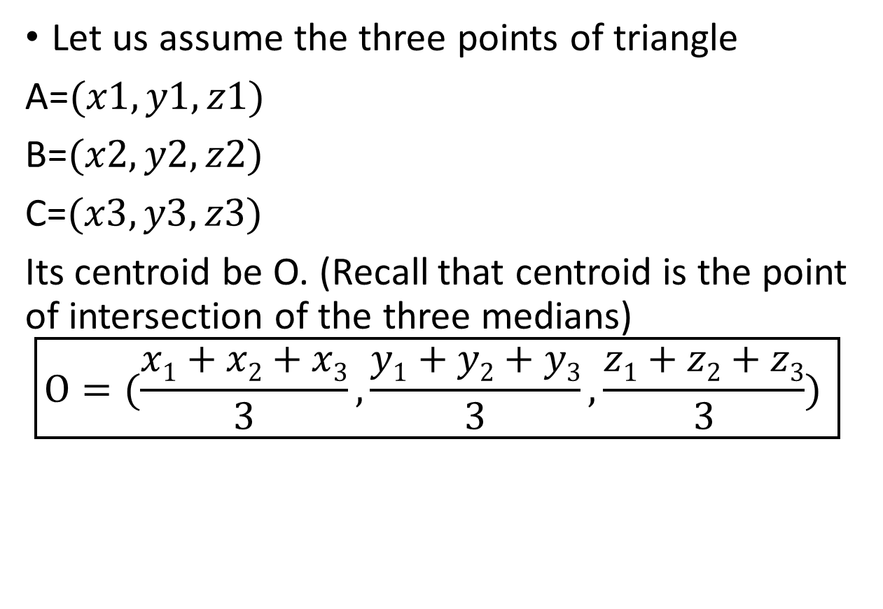
6 Centroid of a triangle
Let us assume the three points of triangle
A=$(x1,y1,z1)$
B=$(x2,y2,z2)$
C=$(x3,y3,z3)$
Its centroid be O. (Recall that centroid is the point of intersection of the three medians)
$$\boxed{O=(\frac{x1+x2+x3}{3},\frac{y1+y2+y3}{3},\frac{z1+z2+z3}{3}) }$$

Slide 11
Thank you
Shreyas M
B.Tech in ECE PES University Bangalore

